Slide 1
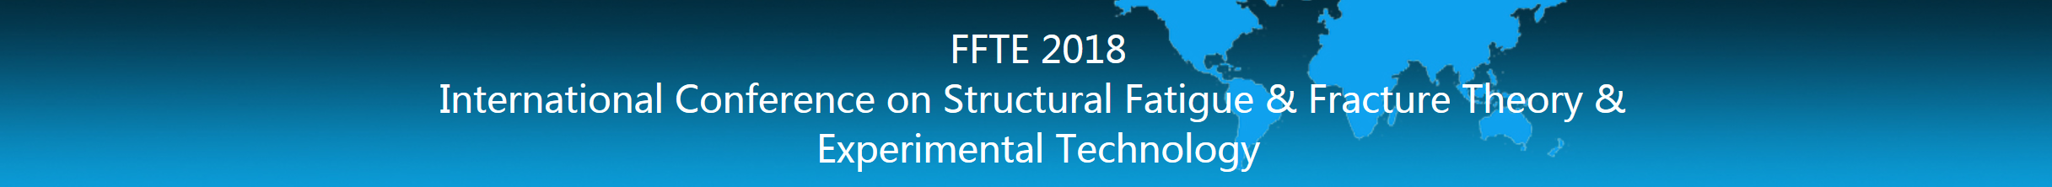
Strength analysis of laminates with circular cutouts under tension
Zheng Li, Jianlin Chen, Pengcheng Chu
State Key Laboratory for Turbulence and Complex Systems, Department of Mechanics and Engineering Science, College of Engineering, Peking University, China

Slide 2
Contents
1
Introduction
2
Numerical Simulations
3
Experiments
4
Results and discussion
5
Conclusions

Slide 3
Contents
1
Introduction
2
Numerical Simulations
3
Experiments
4
Results and discussion
5
Conclusions

Slide 4
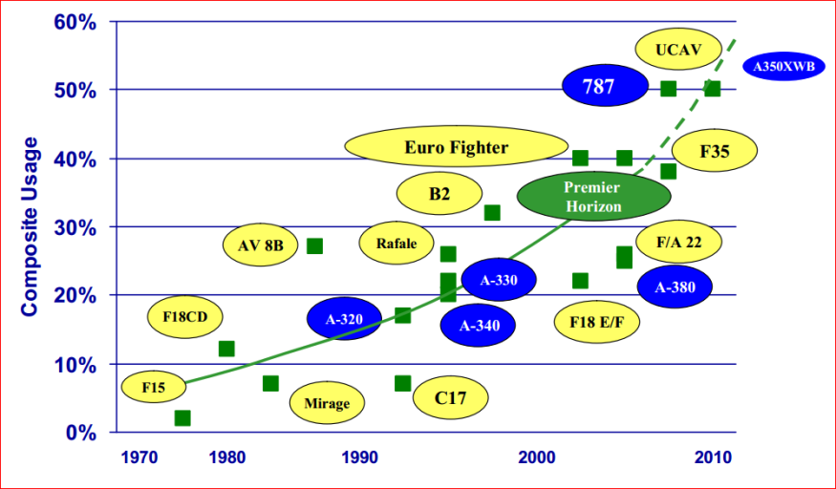
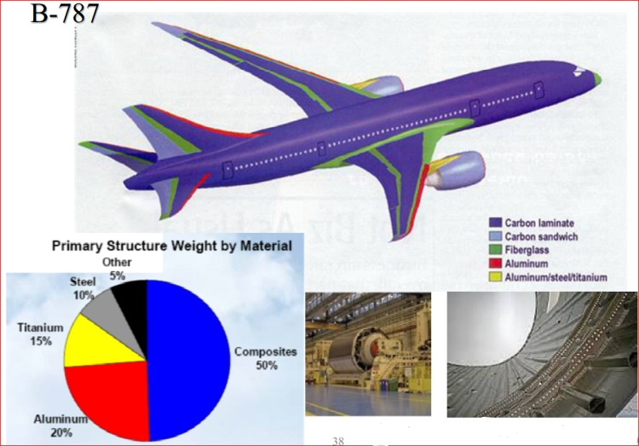

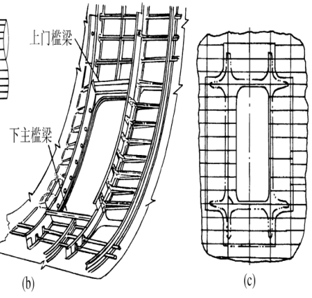
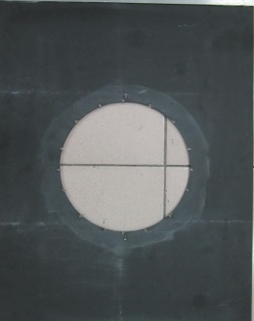
1. Introduction (i)
Aircraft
Composite Structures with Big Cutout inevitably
Notes:
.

Slide 5
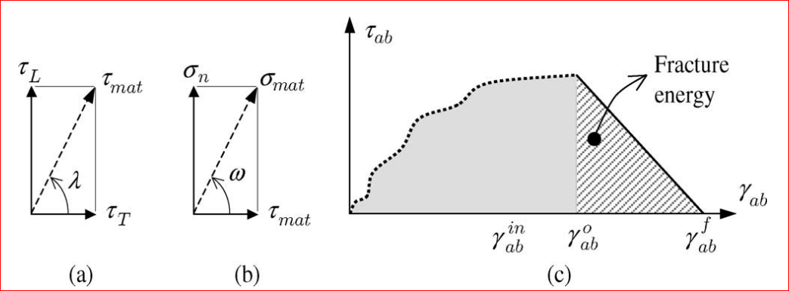
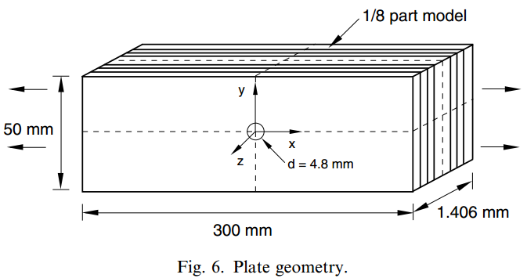
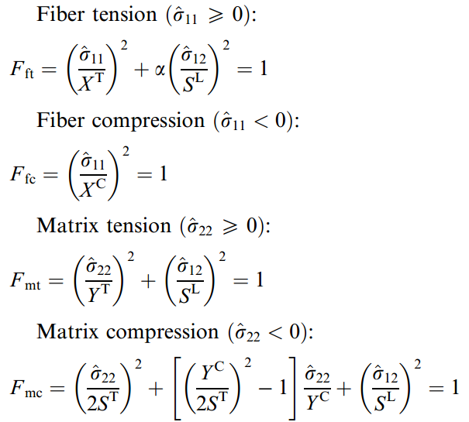
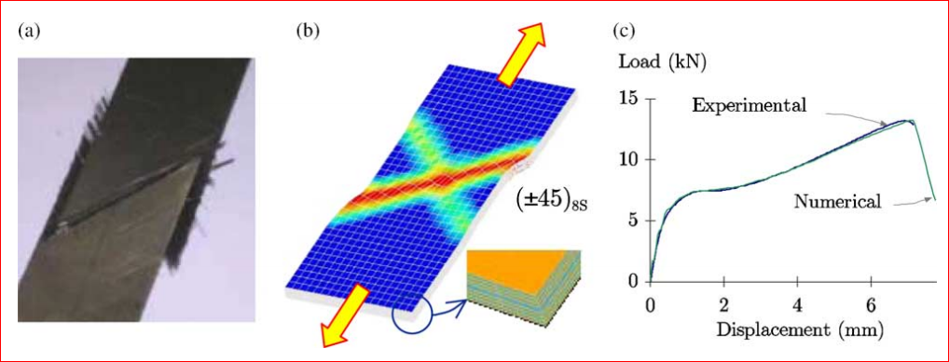
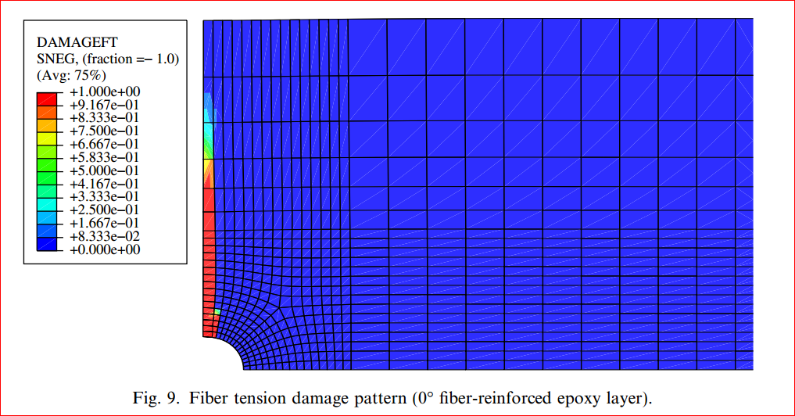
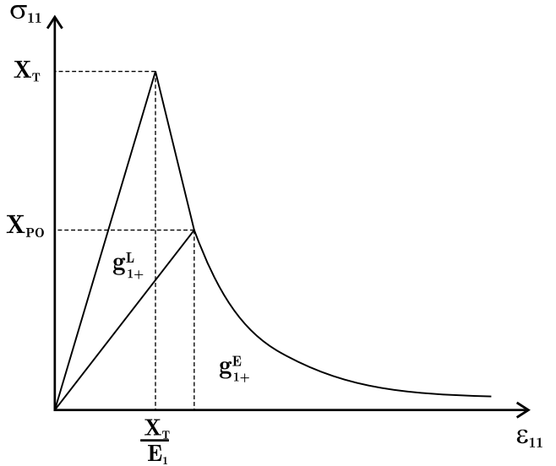
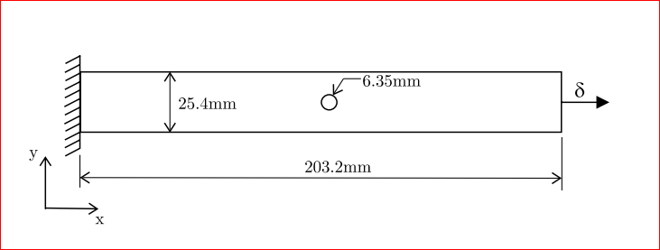
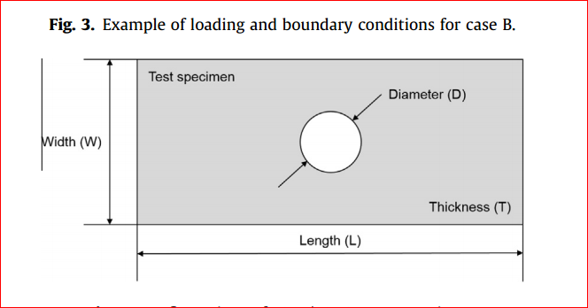
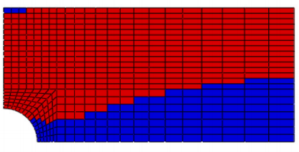
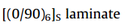
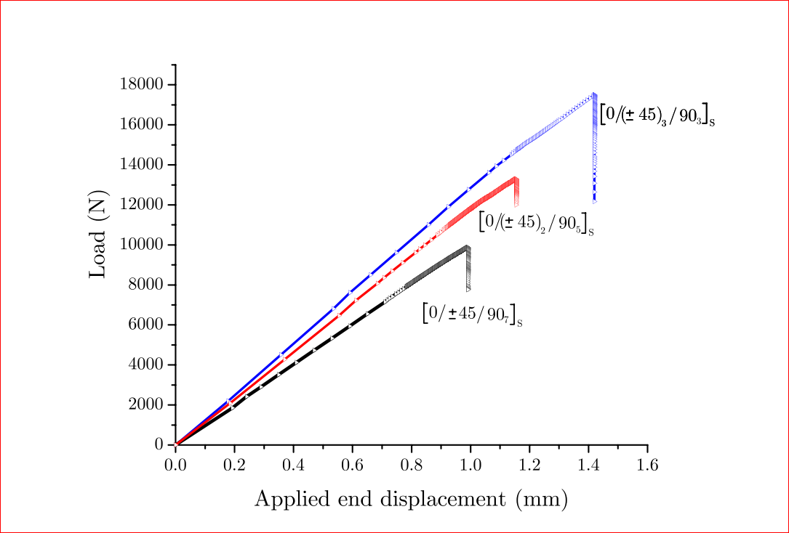
1. Introduction (ii)
S.T. Pinho COMPOS: Part A, 2006(37)
Ireneusz L. COMPOS: Part A, 2007(38)
Chi-Seung Lee COMPOS STRUCT, 2015(121)
P. Maimı´ MECH MATER, 2007(39)
How to predict the failure of laminates with big cutouts？

Slide 6
Contents
1
Introduction
2
Numerical Simulations
3
Experiments
4
Results and discussion
5
Conclusions

Slide 7
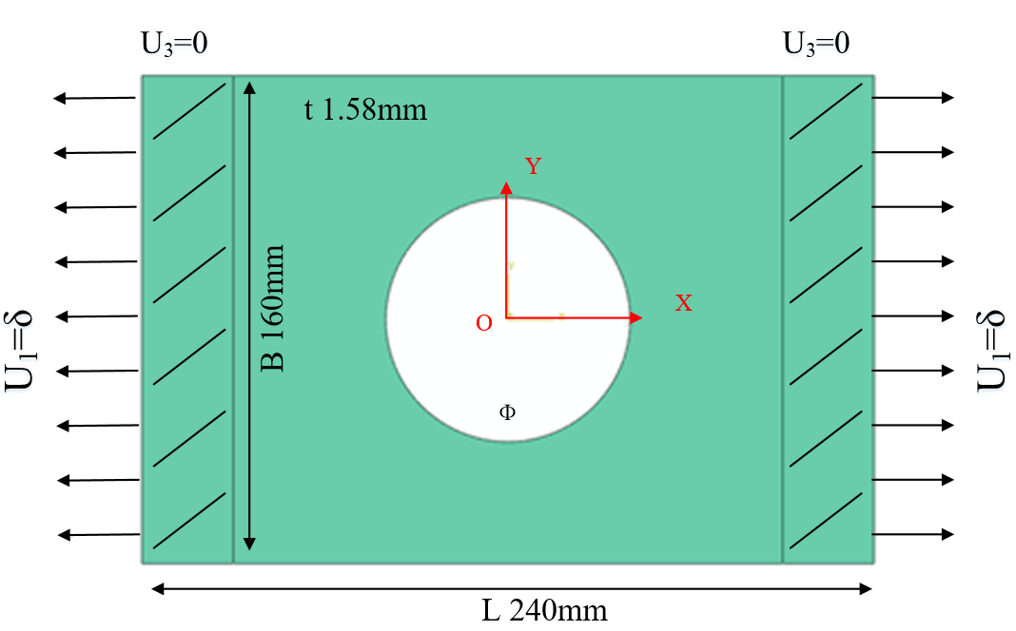
2. Simulation (i)
FEM Model
1: Failure mode
2: Ultimate load
FEM：Abaqus software
Model: 3D Shell SC8R
Strength criterion：Hashin
Ф: 60mm, 80mm, 100mm
Layups: [0˚]₈, [0˚/90˚]_{2S}, [±45˚]_{2S}
Table 1 Material properties of a single lamina (T700/9363)
ρ（kg/m³） | E₁(GPa) | E₂(GPa) | G₁₂(GPa) | υ₁₂
1520.7 | 130.40 | 7.12 | 3.80 | 0.274
Table 2 Strength parameters of a single lamina (T700/9363)
Strength | X_{t} | X_{c} | Y_{t} | Y_{c} | S₁₂
(MPa) | 1781.1 | 1160 | 36.8 | 182 | 88

Slide 8
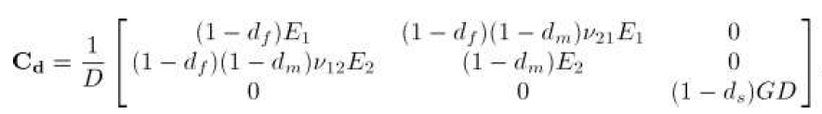
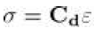
2. Simulation (ii)
Constitutive damage model:
The definition for the ply complementary free energy density:
The strain tensor:
The lamina compliance tensor:
Inverse matrix is the stiffness tensor:
P. Maimí, P.P. Camanho, J.A. Mayugo, et al. A continuum damage model for composite laminates: Part I – Constitutive model[J]. Mechanics of Materials, 2007, 39:897–908.
Notes:
To establish a constitutive law, it is possible to define a scalar function corresponding to the complementary free energy density in the material.The proposed definition for the ply complementary free energy density is:
The damage variables as a measure of the effective surface density of the microdefects.
The strain tensor is equal to the derivative of the complementary free energy density with respect to the stress tensor:

Slide 9
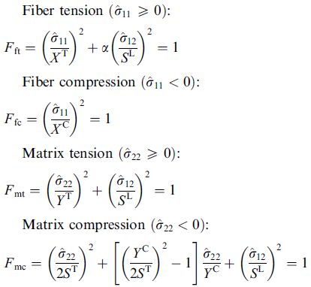
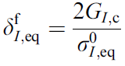
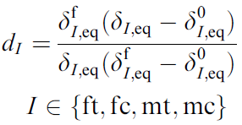
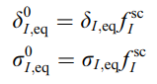
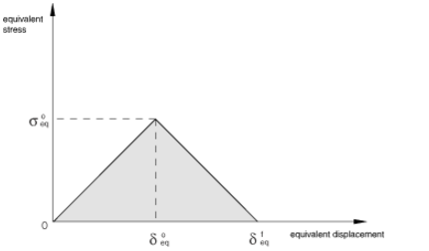
2. Simulation (iii)
Damage Model
Hashin criterion
Continuum Damage Model:
Damage variable
Lapczyk I, Hurtado J A. Progressive damage modeling in fiber-reinforced materials[J]. Composites Part A Applied Science & Manufacturing, 2007, 38(11):2333-2341.
Notes:
In the failure simulation, we use the Hashin criterion to determine the crack’s happening, and then use the linear continuum damage model to simulate the crack’s propagation.

Slide 10
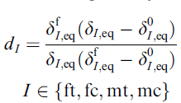
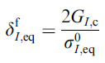
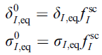
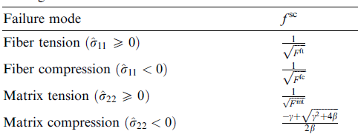
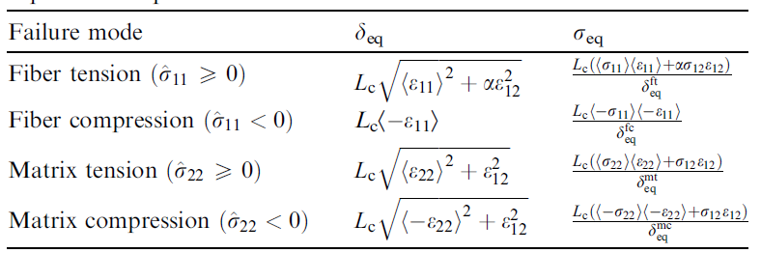
2. Simulation (iv)
Damage variables calculation：
damage variables:
Jacobian matirx:
Notes:
在传统强度理论研究中，通常将单向板试验获得的拉伸、压缩和剪切强度值作为材料的固有属性并用于建立强度准则，进而预测多向层合板的强度。然而通过一系列试验研究发现，对于铺层方向和厚度都相同的子层，它在多向层合板内和在单向板内时表现出的基体强度（包括横向拉伸和剪切强度）不同，在层合板内表现的强度明显高于在单向板内，许多文献将层合板的这种现象称为就地效应（in-situ effect）。
By examining the results presented previously,5±7 we take the in-situ tensile transverse and shear strengths to be 1.5 times those measured from unidirectional laminates for all the laminates discussed.

Slide 11
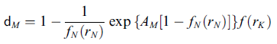
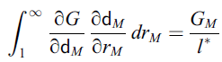
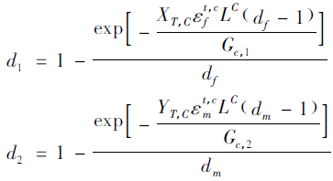
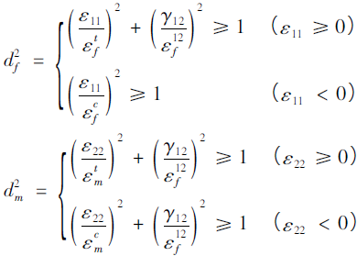
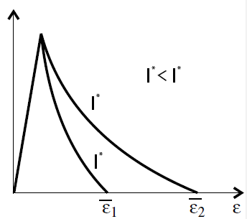
2. Simulation (v)
Linear degenaration:
Exponential degenaration:
Damage variable:
Damage variable:
Maimí P, Camanho P P, Mayugo J A, et al. A continuum damage model for composite laminates: Part II – Computational implementation and validation[J]. Mechanics of Materials, 2007, 39(10):909–919.
Lapczyk I, Hurtado J A. Progressive damage modeling in fiber-reinforced materials[J]. Composites Part A Applied Science & Manufacturing, 2007, 38(11):2333-2341.
Damage and Failure Study of Composite Laminates with
Reinforced Cutout Based on CDM
Wang Wenzhi，Wan Xiaopeng，Yao Liaojun
Notes:
基于不可逆过程的热力学，将势能定义为损伤变量的函数，损伤变量定义了应力应变的关系，同时取决于能量耗散值
所有使用参数均可测量得到
可以模拟材料的弹脆性行为
可以计算层合板的损伤演化过程
在abaqus中使用UMAT子程序实现

Slide 12
2. Simulations (vi)
Flowchart of failure process：
each increment
UMAT subroutine
calculate strain and undamaged stiffness matrix
calculate damage variable d and
calculate stress
undamaged
calculate damaged stiffness matrix
checkout failure ( Hashin
criterion)
damaged
calculate stress and Jacobian matirx; update damage variable d
quit UMAT,back to main program
Notes:
Here is the flowchart of failure process.

Slide 13
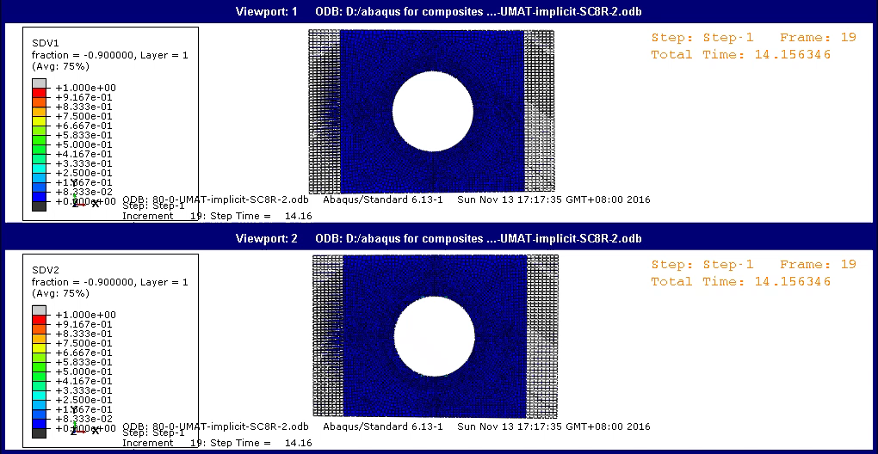
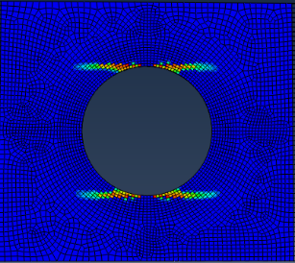
2. Simulations (vi)
Failure mode and crack propagation
[0]₁₀ unidirectional-ply & Ф80mm
Fiber failure
Matrix failure
Notes:
Here is the simulation results, the failure mode and crack propagation of unidirectional-ply with cutout Phi 80mm. We can see the failure process, each of fiber and matrix. So the matrix failure occurs, but the fiber not break. The total failure mode like this.

Slide 14
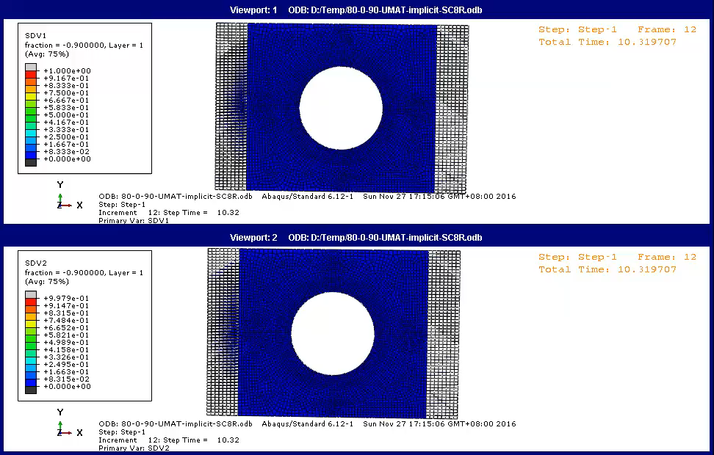
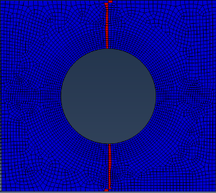
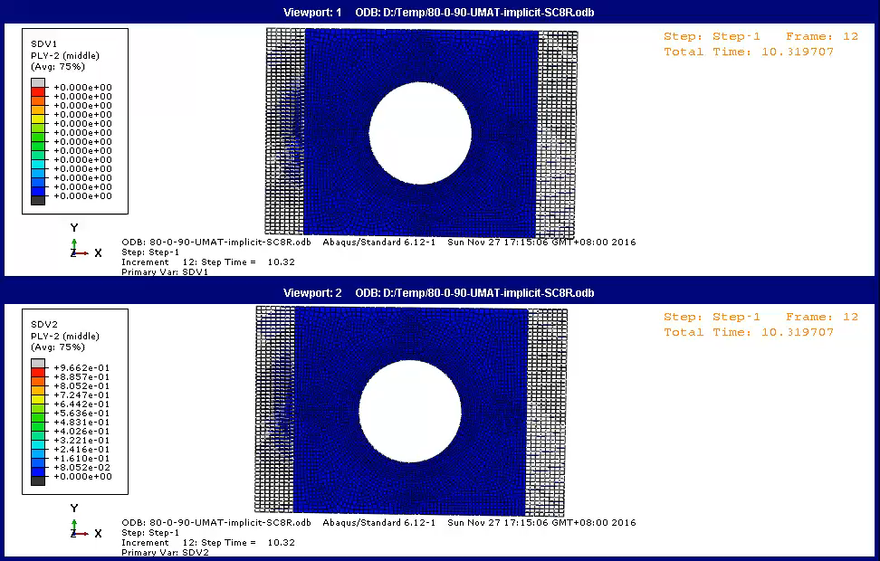

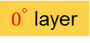
2. Simulations (vii)
[0/90]₅ cross-ply & Ф80mm
Fiber failure
$0^{°}$ layer
Matrix failure
Fiber failure
${90}^{°}$ layer
Matrix failure
Notes:
Also we can see the cross-ply’s results. In the 0 degree layer, the fiber failure and matrix failure both happen. But in the 90 degree layer, just there is the matrix failure. And here is the final crack propagation path.

Slide 15
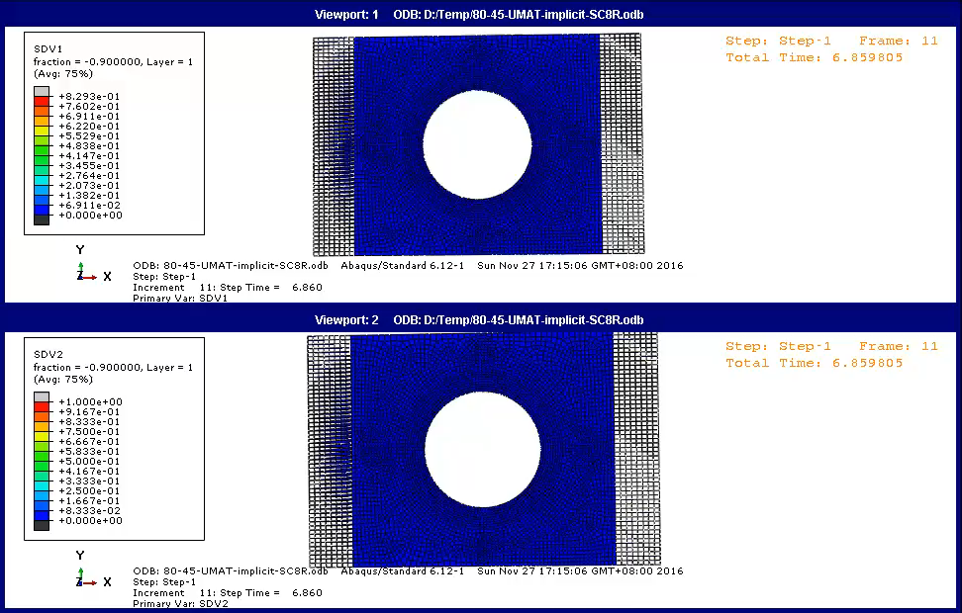
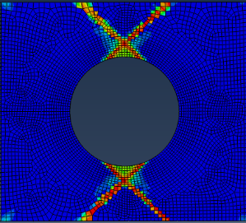
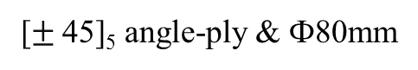
2. Simulations (viii)
[$±$45]₅ angle-ply & Ф80mm
Fiber failure
Matrix failure
Notes:
In the angle-ply, we can only see the matrix failure.

Slide 16
Contents
1
Introduction
2
Numerical Simulations
3
Experiments
4
Results and discussion
5
Conclusions

Slide 17
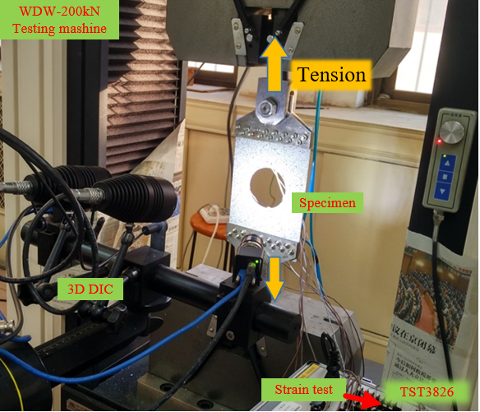
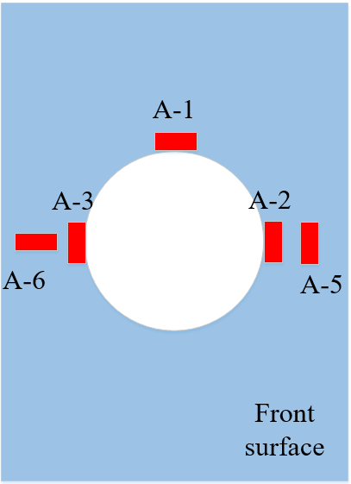
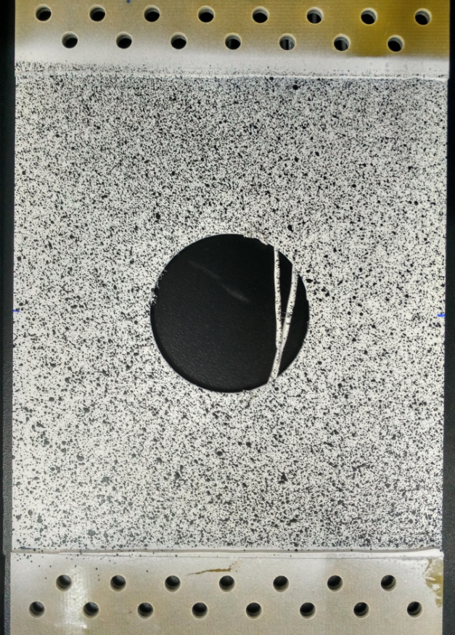
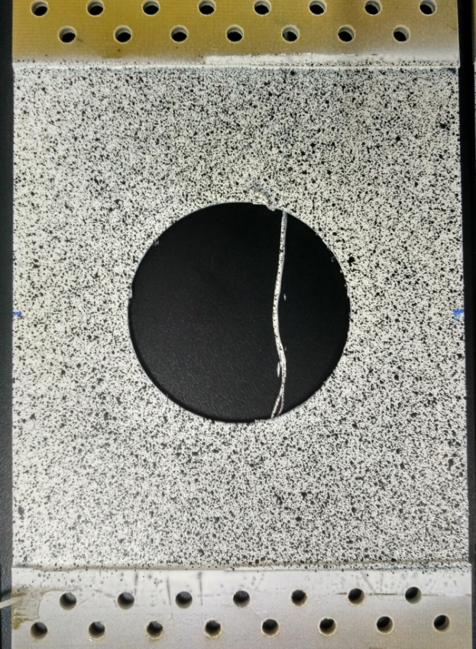
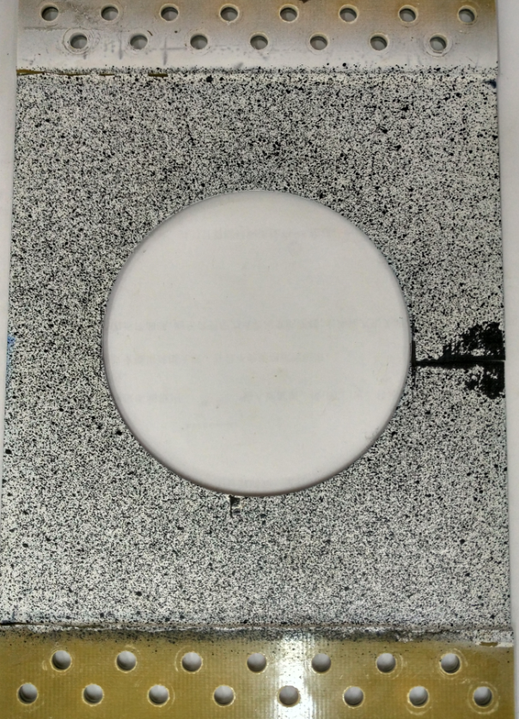
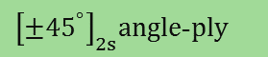
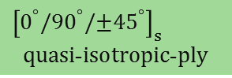


3. Experiments (i)
Experiment system
Strain gauges sketch
Layup sequences
${\left[0^{°}\right]}_{8}$ unidirection-ply
${\left[0^{°}{/90}^{°}\right]}_{2s}$cross-ply
$${\left[{±45}^{°}\right]}_{2s}angle\text{−}ply$$
$${\left[0^{°}{/90}^{°}/{±45}^{°}\right]}_{s}$$
$$quasi\text{−}isotropic\text{−}ply$$
Loading mode
Displacement control by 0.5mm/min
DIC speckle (Front side)
3D Digital Image Correlation (DIC) test
PMBLAB DIC-3D system Pro
Camera: 2448*2048pix
Images: 1f/kN
Correlation algorithms: ZNSSD
Cutouts: (a) Ф60mm (b) Ф80mm (c) Ф100mm
Notes:
Here is the experiment system. We use strain gauges and 3 dimension digital image correlation method to measure the strain. Here is DIC speckle. We also consider 4 types of layup and 3 sizes of cutout.

Slide 18




3. Experiments (ii)
Strain comparison between strain gauges, DIC and simulation results
${\left[0^{°}{/90}^{°}\right]}_{2s}$- Ф60mm
$$Error<2\%$$
Strain
Gauges
DIC
Test points
Notes:
In the experiment, we compare the strain results between the gauges, DIC and simulation. Here are the strain testing points. The 3 results are in good agreement. So the DIC testing method is ok.

Slide 19




3. Experiments (iii)
Load-Displacement Curves
Ф60
Ф80
Ф100
The failure process is like a brittle fracture
ε₁
ε₁
${\left[0^{°}\right]}_{8}$-H80
${\left[0^{°}/{90}^{°}\right]}_{2s}$-H80
Notes:
Here are load-displacement curves. The curves go straight up, and drop down at last. So the failure process is like a brittle fracture.
In the unidirectional-ply loading curve, we find that there are some little drop down points. It means the cracks occur. The DIC results can show that. But in the other layup specimens, we can’t see this situation.

Slide 20








3. Experiments (iv)
Strain/Stress concentration
v
x
y
$${\left[0^{°}\right]}_{8}$$
$${\left[0^{°}{/90}^{°}\right]}_{2s}$$
$${\left[{±45}^{°}\right]}_{2s}$$
$${\left[0^{°}{/90}^{°}/{±45}^{°}\right]}_{s}$$
Strain ε_{x}
in Cutout Ф80mm by DIC at 10kN
SCF results
by Exp.
60 80 100
Notes:
According to the strain epsilon x results, we can see the strain/stress concentration happen.
And here are the stress concentration factor results by strain gauges testing. It shows that the cutouts bigger, the stress concentration factors larger.

Slide 21











3. Experiments (v)
Failure Modes
$${\left[0^{°}\right]}_{8}−\text{Ф}60$$
$${\left[0^{°}/{90}^{°}\right]}_{2s}−\text{Ф}60$$
$${\left[±{45}^{°}\right]}_{2s}−\text{Ф}100$$
$${\left[0^{°}/{90}^{°}/±{45}^{°}\right]}_{s}−\text{Ф}60$$
（cracks along $0^{°}$）
（cracks along ${90}^{°}$）
（cracks along ${45}^{°}$）
Ultimate loads
60 80 100
Notes:
Here are the failure modes of each layup specimens. In the unidirectional-ply, the cracks propagation along the 0 degree. In the cross-ply, the cracks along the 90 degree.
In the angle-ply, the cracks along the 45 degree. In the quasi-isotropic-ply, the cracks along the 90 and 45 degree, depend on the layers. We also calculate the total failure loads or the final strength loads. The unidirectional-ply, the black bars, can support the highest loads, and the angle-ply, the blue bars, the lowest.

Slide 22
Contents
1
Introduction
2
Numerical Simulations
3
Experiments
4
Results and discussion
5
Conclusions

Slide 23









4. Results and discussion (i)
Failure evolution：
[0]₁₀
60mm
80mm
100mm
Linear degenaration
Exponential degenaration

Slide 24















4. Results and discussion (ii)
Failure evolution：Exponential degenaration
[0/90]₅
0 ply
90 ply
60mm
80mm
100mm
fiber
matrix
fiber
matrix

Slide 25


4. Results and discussion (iii)
Ultimate loading：
[0/90]₅
Simulation
Experiment
[0/90]₅ | 60 |  |  | 80 |  |  | 100
 | Simul. | Exp. | Relative error | Simul. | Exp. | Relative error | Simul. | Exp. | Relative error
Linear | 52.67 | 59.32 | 11.2% | 43.83 | 47.20 | 7.1% | 34.56 | 37.54 | 7.9%
Exponential | 56.72 |  | 4.4% | 48.17 |  | 2.1% | 34.59 |  | 7.9%
Notes:
1、从试验以及模拟的结果来看，裂纹的扩展和孔径大小无关，孔径越小，极限载荷越大
2、计算结果可以表现出[0/90]₅板的脆性断裂，
3、linear或是exponential模型对损伤演化的影响不太大，exponential比linear计算极限载荷的误差更小

Slide 26









4. Results and discussion (iv)
Failure evolution：
[±45]₅
Linear degenaration
Exponential degenaration
60mm
80mm
100mm

Slide 27


4. Results and discussion (v)
Ultimate loading：
[±45]₅
Simulation
Experiment
Φ | 60 |  |  | 80 |  |  | 100
[±45]5 | Simul. | Exp. | Relative error | Simul. | Exp. | Relative error | Simul. | Exp. | Relative error
Linear | 21.41 | 28.72 | 25.5% | 17.03 | 23.79 | 28.4% | 12.75 | 17.60 | 27.6%
Exp. | 27.34 |  | 4.8% | 21.73 |  | 8.7% | 16.09 |  | 8.6%
Notes:
1、从试验以及模拟的结果来看，裂纹的扩展和孔径大小无关，孔径越小，极限载荷越大
2、linear或是exponential模型对损伤演化的影响不太大，极限载荷：exponential比linear误差更小
4、位移载荷曲线的形状和实验相差大

Slide 28

4. Results and discussion (vi)
Shear Nonlinearity:
Shear nonlinearity constitutive relations for the laminates were defined with the Ramberg-Osgood equation:
n is a parameter define the shape of the nonlinear stress-strain relationship.
The displacement-load curve is closer to the experiment when n=2.

Slide 29



4. Results and discussion (vii)
Shear Nonlinearity:
No Shear Nonlinearity
N=2
Experiment
Problem:The load of the curve doesn't drop in the simulation result.

Slide 30

4. Results and discussion (viii)
Φ | 60 |  |  | 80 |  |  | 100
[±45]5 | Simul. | Exp. | Relative error | Simul. | Exp. | Relative error | Simul. | Exp. | Relative error
No shear nonlinearity | 27.34 | 28.72 | 4.8% | 21.73 | 23.79 | 8.7% | 16.09 | 17.60 | 8.6%
Shear nonlinearity | 26.81 |  | 6.7% | 21.39 |  | 10.1% | 16.01 |  | 9.0%

Slide 31
Contents
1
Introduction
2
Numerical Simulations
3
Experiments
4
Results and discussion
5
Conclusions

Slide 32
5. Conclusions
Failure process is a typical brittle fracture;
Failure onset is at the stress concentration area, ultimate strength is effected by the design of ply sequences and decreases with the size of cutout increase
The failure evolution of laminates doesn't affected by the size of cutout, and the failure of each single layer always includes different failure modes.
The continuum damage model preforms well for predicting the failure evolution behavior of composite laminates with big cutouts. The shear nonlinearity must be considered for the [±45]5 layup laminates.

Slide 33


Acknowledgement
Project supported by the National Natural Science
Foundation of China (No. 11232001)
Thank you for your attention
Zheng Li
Email: lizheng@pku.edu.cn

